Slide 1
Dorchester Abbey School Visits
Let us plan a stimulating visit for you

Slide 2
What we have
A 12th century monastic church of outstanding beauty – now a parish church
On the site of the first cathedral in Saxon Wessex
In an area with evidence of 6000 years of continuous occupation

Slide 3
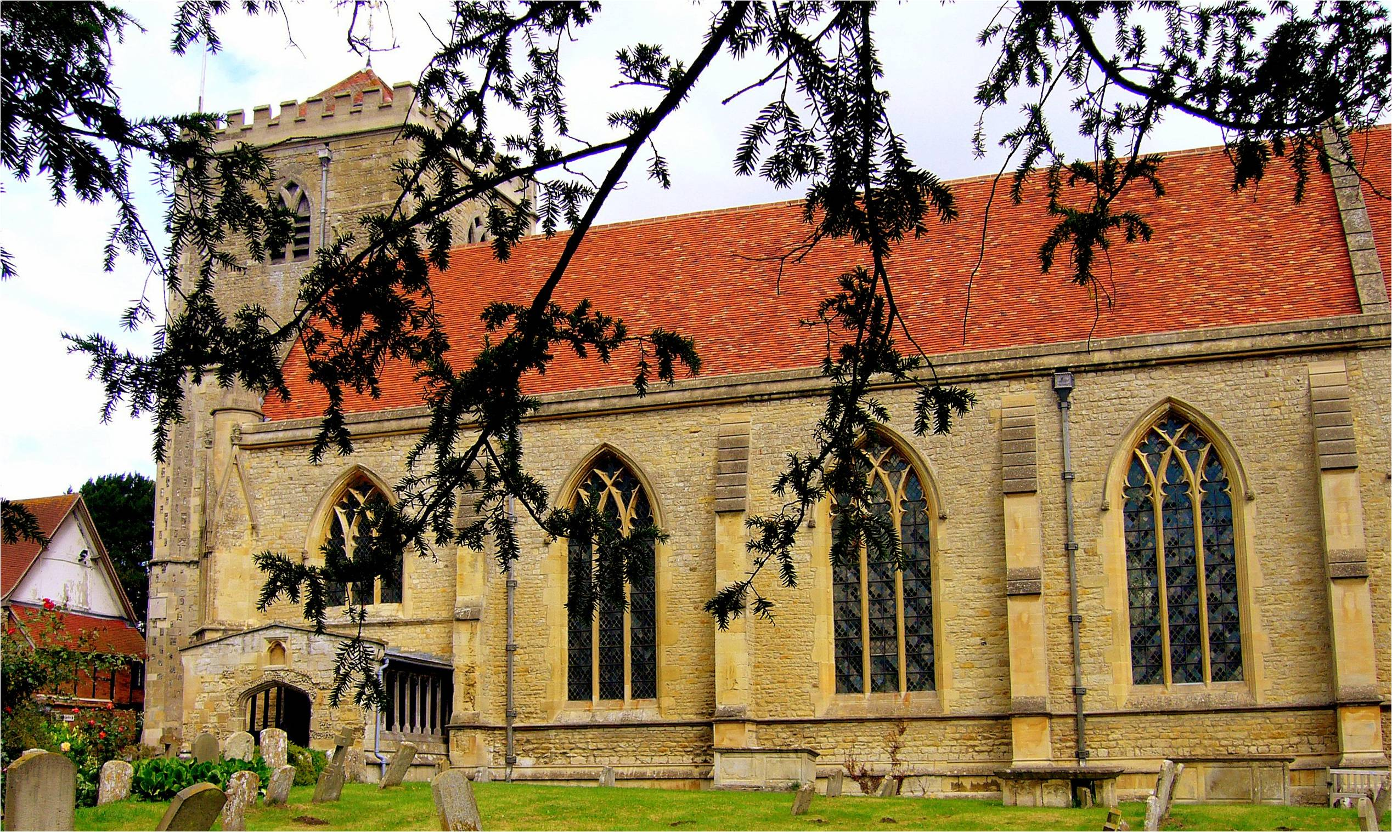
The Abbey Church

Slide 4
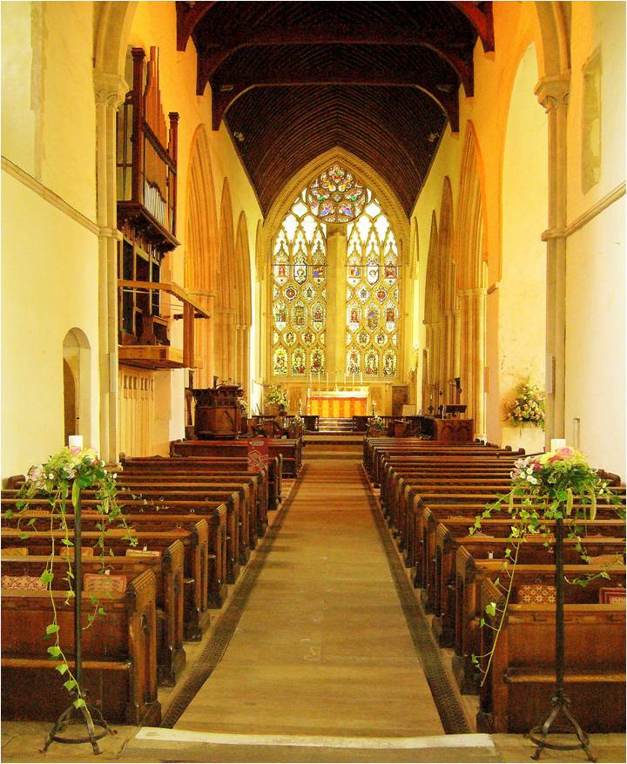
An architectural gem

Slide 5
What can we offer?
A varied day or half day visit to fulfil your learning outcomes and support the National Curriculum requirements
Each visit individually planned at a preliminary meeting
Activities can be led by Abbey staff or by school’s own teachers
All study material prepared for you

Slide 6
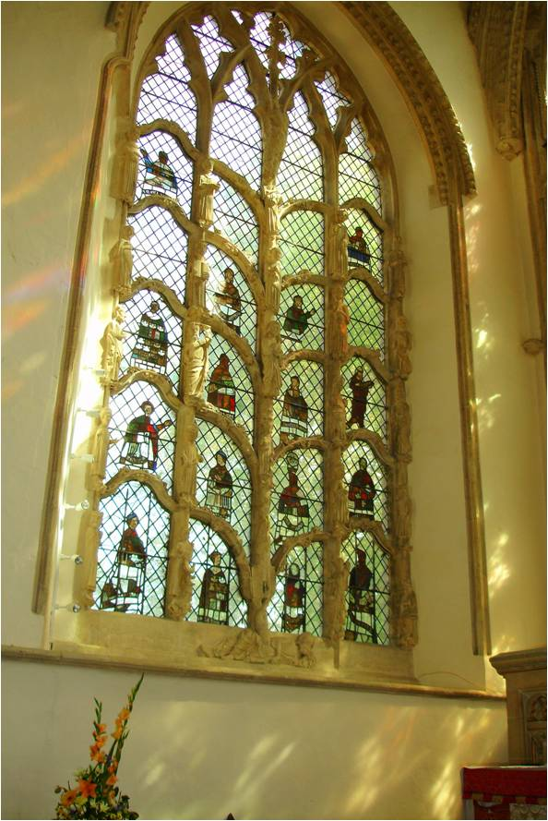
Explore the Abbey
Find out who built it, when and why
Enjoy the architecture and the skill of the craftsmen
Handle the materials
Discover what history the Abbey has seen in 900 years
Learn about what is in a church

Slide 7
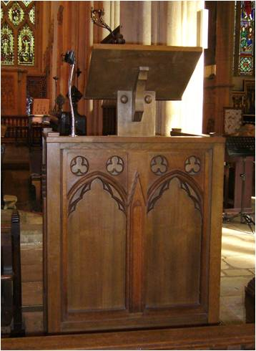
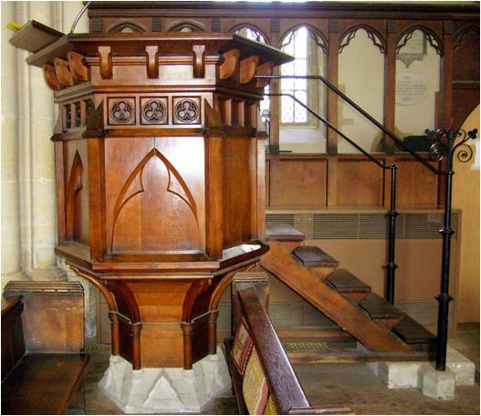
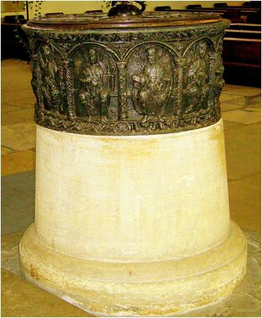
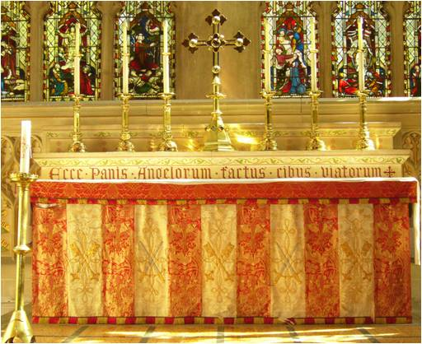

Slide 8
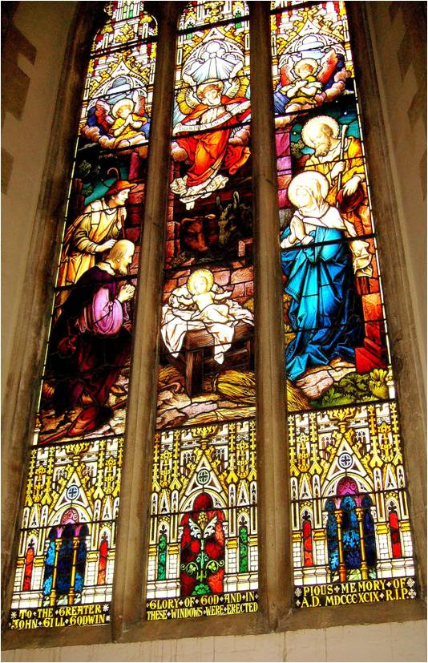
Study …the windows
Discover the stories told by these medieval story books
Look at glass painted in the 13th and 14th centuries

Slide 9
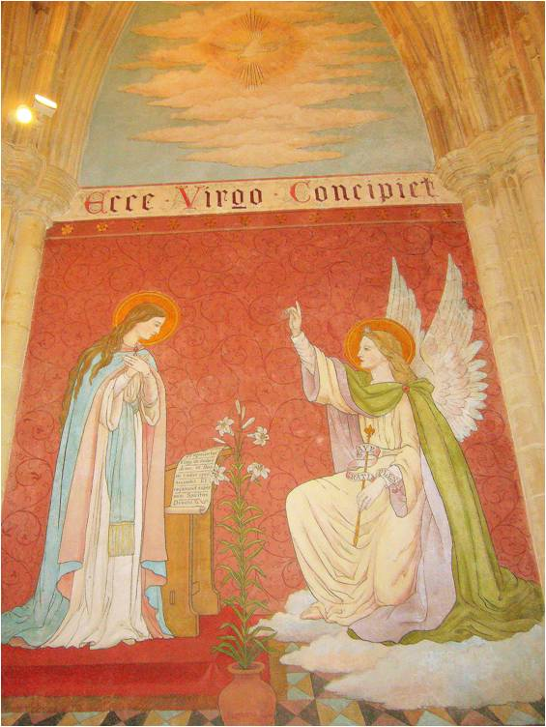
Study …. the wall paintings
See the work of the Medieval and Pre-Raphaelite painters
Understand the symbolism in their paintings

Slide 10
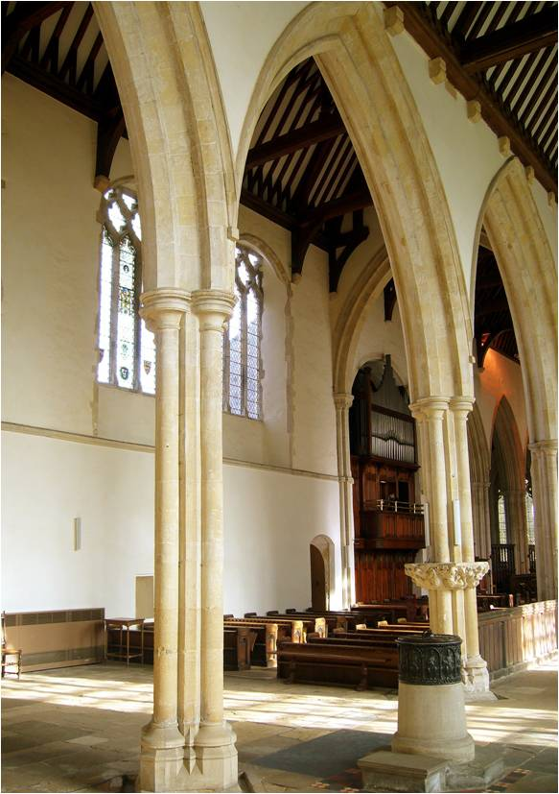
Study… the stonework
Let the shape of an arch, a window or a doorway tell you when it was built
Examine the intricate patterns carved by the medieval and Victorian craftsmen

Slide 11
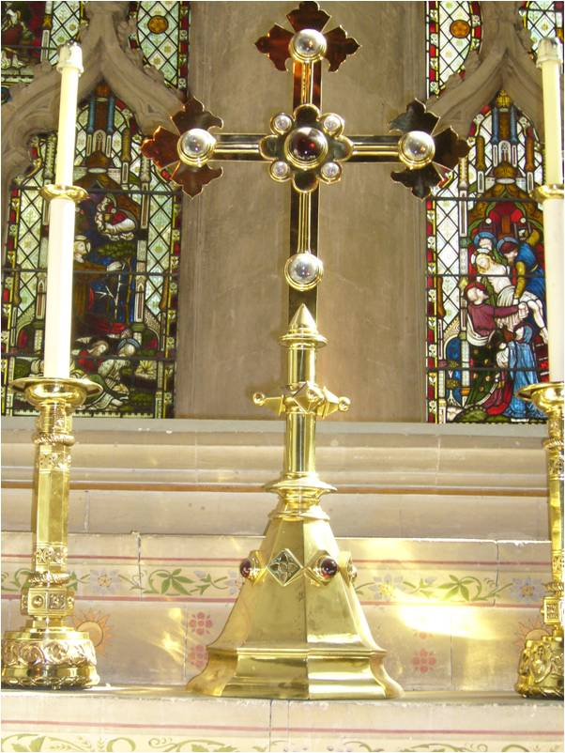
Study … the signs and symbols of Christianity
Follow the trail around the Abbey and learn to identify and interpret the symbolism of the Christian religion seen in the stone, wood, glass, paint and textiles of the Abbey

Slide 12
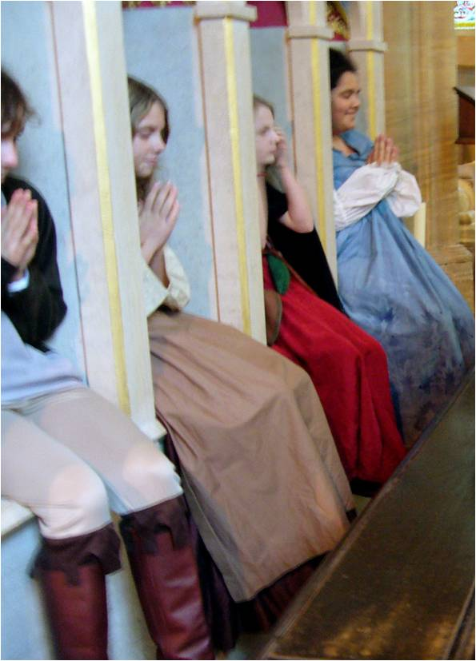
Study … a theme
Discuss BAPTISM and act out the baptism ceremony of the Church of England
Come dressed as a pilgrim and learn about medieval PILGRIMAGE through drama and craft activities
Explore aspects of CHRISTIANITY through your senses, poetry, prayers and activities

Slide 13
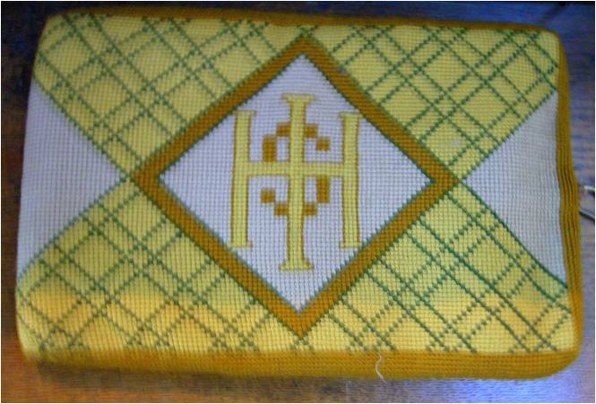
Study …Maths
Follow the Maths Trails and discover the importance of measurement, shape, symmetry, tessellation – and more

Slide 14
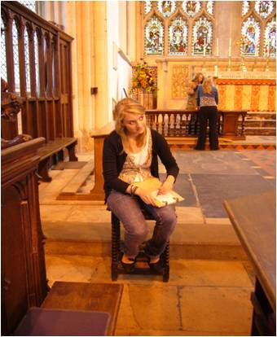
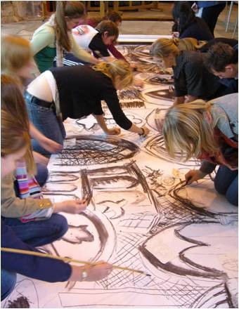
Study …Art
Spend time carefully drawing the beautiful structures around you, rub a collection of textures or design your own stained glass window

Slide 15
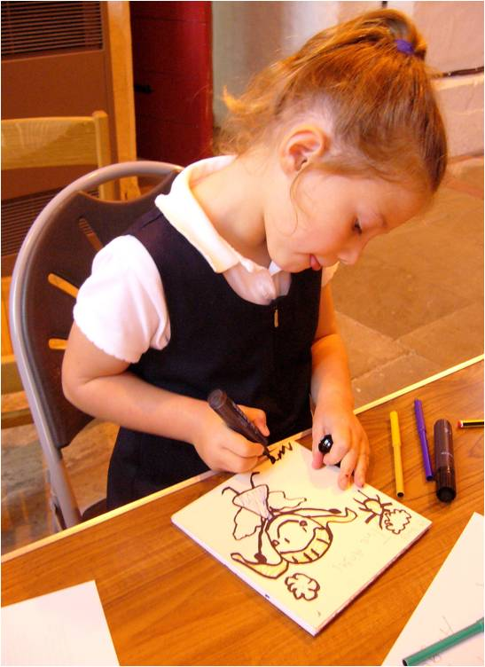
Study …English
Be inspired to write by the surroundings – stories, poems, prayers, drama
Hold your own sharing experience at the end of your visit with music and the spoken word

Slide 16
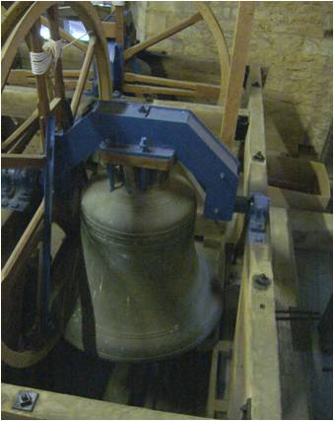
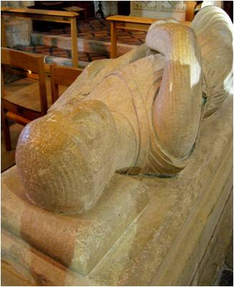
Study …Science
Find out about MATERIALS AND THEIR USES and handle different materials
Look for evidence of FORCES at work in the structure of the Abbey and what effect they have had.

Slide 17
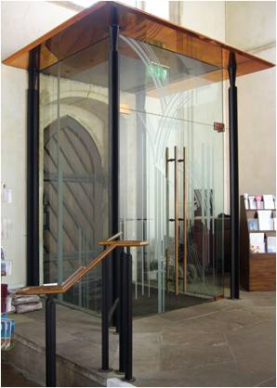
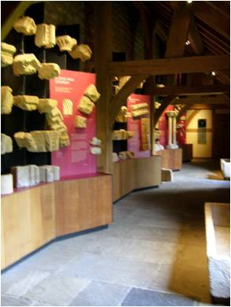
Study … the contemporary as well as the historic
Admire the blending of the work of the modern craftsmen with that of the medieval and Victorian experts
Discuss the relevance of the building and its contents in today’s Christianity

Slide 18
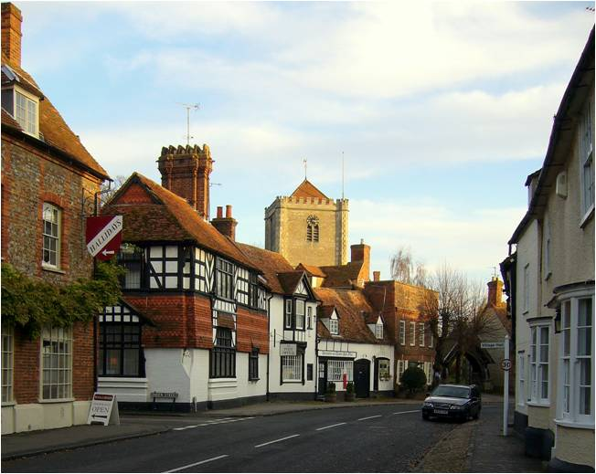
Study … the Abbey as part of a village study
Learn the techniques of a village study by discovering why the Abbey was built in Dorchester and the links it has had with the community throughout history

Slide 19
Where are we?
Dorchester on Thames is signed from the A4074 Oxford to Henley on Thames road 8 miles south of Oxford.
The Abbey is on the High Street in the centre of the village with coach dropping- off facilities outside and nearby parking.

Slide 20
What to do now
For BOOKING and for FURTHER INFORMATION contact:
Sue Dixon, Education Officer on 01865 343164 or on education@dorchester-abbey.org.uk
Please ask if your particular interest has not been shown as we have only been able to show a sample of what Dorchester Abbey has to offer to pupils of all ages

